Slide 1
Intelligent Agents
Chapter 2

Slide 2
Outline
Agents and environments
Rationality
PEAS (Performance measure, Environment, Actuators, Sensors)
Environment types
Agent types

Slide 3
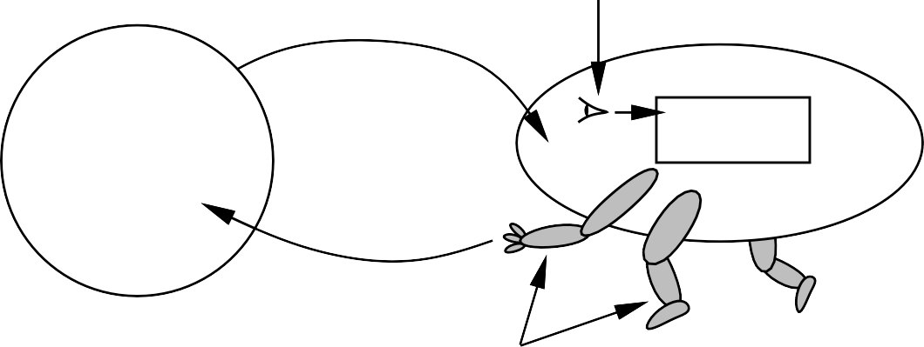
Conceptual Model: Agents and environments
sensors
percepts
?
agent
environment
actions
actuators
Agents include humans, robots, softbots, thermostats, etc.
The information in this model represents facts about the environment, observed using the percepts P, and effects on the environment, caused by the actions A
The agent intelligent function f maps the agent perceptions to actions:
f : P∗ → A
The agent program runs actuators on the physical architecture to produce the agent function f

Slide 4







Example: Vacuum-cleaner world
A B
Percepts: location and contents, e.g., [A, Dirty]
Actions: Left, Right, Suck, N oOp

Slide 5
Example: A vacuum-cleaner agent
Percept sequence | Action
[A, Clean] | Right
[A, Dirty] | Suck
[B, Clean] | Left
[B, Dirty] | Suck
[A, Clean], [A, Clean] | Right
[A, Clean], [A, Dirty] | Suck
. | .
function Reflex-Vacuum-Agent( [location,status]) returns an action
if status = Dirty then return Suck
else if location = A then return Right
else if location = B then return Left
What is the Right function?
Can it be implemented in a small agent program?

Slide 6
Rationality
Fixed performance measure evaluates the environment history, for example
one point per square cleaned up in time T ?
one point per clean square per time step, minus one per move?
penalize for > k dirty squares?
A rational agent chooses whichever action maximizes the expected value of the performance measure given the percept sequence to date
Rational ≠ omniscient
percepts may not use all relevant information
Rational ≠ clairvoyant
action outcomes may not be as expected
Hence, rational ≠ successful
Rationality ⇒exploration, learning, autonomy!

Slide 7
Rationality vs. Emotions
Rationality is based on causal dependence which can be formalized using logics, i.e. it is objective since the logics is common
Unlike the rationality, the emotions are based on individual perceptions, i.e. they are subjective because you cannot unify the individual feelings
Can we analyse the emotions?
Yes - Sentiment analysis
Can we build “emotional” agents?
To some extent – We can model the emotions and use them to determine the behaviour
The problem which remains is that the match between emotions and perceptions will be algorithmic, i.e., rational
Emotions ⇒perceptions, feelings, reactions!

Slide 8
Principles of Design (PEAS)
To design a rational agent, beforehand we must first specify the task which the agent must attend together with the criteria for measuring the success for achieving it in order to be counted as rational, and the environment in which the agent will act
Performance measure
Environment
Then we can construct the agent in accordance with the principle of rationality we have adopted
Actuators
Sensors

Slide 9
Example: Taxi Agent
Consider, e.g., the task of designing an autonomous driverless taxi:
Performance measure: safety, destination, profits, legality, comfort, . . .
Environment: UK streets/freeways, traffic, pedestrians, weather, . . .
Actuators: steering, accelerator, brake, horn, speaker/display, . . .
Sensors: video, accelerometers, gauges, engine sensors, keyboard, GPS, . . .

Slide 10
Example: Internet shopping agent
Performance measure??
Environment??
Actuators??
Sensors??

Slide 11
Internet shopping agent
Performance measure?? price, quality, appropriateness, efficiency, feedback …
Environment?? WWW sites, vendors, sellers, transporters …
Actuators?? display to user, follow URL, fill in form, confirm payment …
Sensors?? HTML pages (text, graphics, video, scripts)

Slide 12
Environment types
 | Solitaire Backgammon Internet shopping Taxi
Observable?? Deterministic?? Episodic?? Static?? Discrete?? Single-agent??

Slide 13
Examples: Environment types
 | Solitaire Backgammon Internet shopping Taxi
Observable?? Deterministic?? Episodic?? Static?? Discrete?? Single-agent?? | Yes Yes No No

Slide 14
Examples: Environment types
 | Solitaire Backgammon Internet shopping Taxi
Observable?? Deterministic?? Episodic?? Static?? Discrete?? Single-agent?? | Yes Yes No No Yes No Partly No

Slide 15
Environment types
 | Solitaire Backgammon Internet shopping Taxi
Observable?? Deterministic?? Episodic?? Static?? Discrete?? Single-agent?? | Yes Yes No No Yes No Partly No No No No No

Slide 16
Examples: Environment types
 | Solitaire Backgammon Internet shopping Taxi
Observable?? Deterministic?? Episodic?? Static?? Discrete?? Single-agent?? | Yes Yes No No Yes No Partly No No No No No Yes Semi Semi No

Slide 17
Examples: Environment types
 | Solitaire Backgammon Internet shopping Taxi
Observable?? Deterministic?? Episodic?? Static?? Discrete?? Single-agent?? | Yes Yes No No Yes No Partly No No No No No Yes Semi Semi No Yes Yes Yes No

Slide 18
Examples: Environment types
 | Solitaire Backgammon Internet shopping Taxi
Observable?? Deterministic?? Episodic?? Static?? Discrete?? Single-agent?? | Yes Yes No No Yes No Partly No No No No No Yes Semi Semi No Yes Yes Yes No Yes No Yes (except auctions) No
The environment type largely determines the agent design
The real world is (of course) partially observable, stochastic, sequential, dynamic, continuous, multi-agent

Slide 19
Agent types
Four basic types of agents in order of increasing generality:
simple reflex agents (no internal state, just reactions to the sensed environment); Example: amoeba which contract each time when pocked
reflex agents with state (the reactions also depend on the internal state of the agent); Example: memory cells which provide different content when approached
goal-based agents (the agents not only react to sensations from the environment, but can also act upon the environment in accordance with their own goals); Example: computer games playing against the user
utility-based agents (the agents may formulate their own goals, which depend on their own state and the state of the environment in which they act); Example: Robots
All these can be turned into learning agents, which can also learn from the past experience and improve their reflexes, reactions, goals, or principles

Slide 20
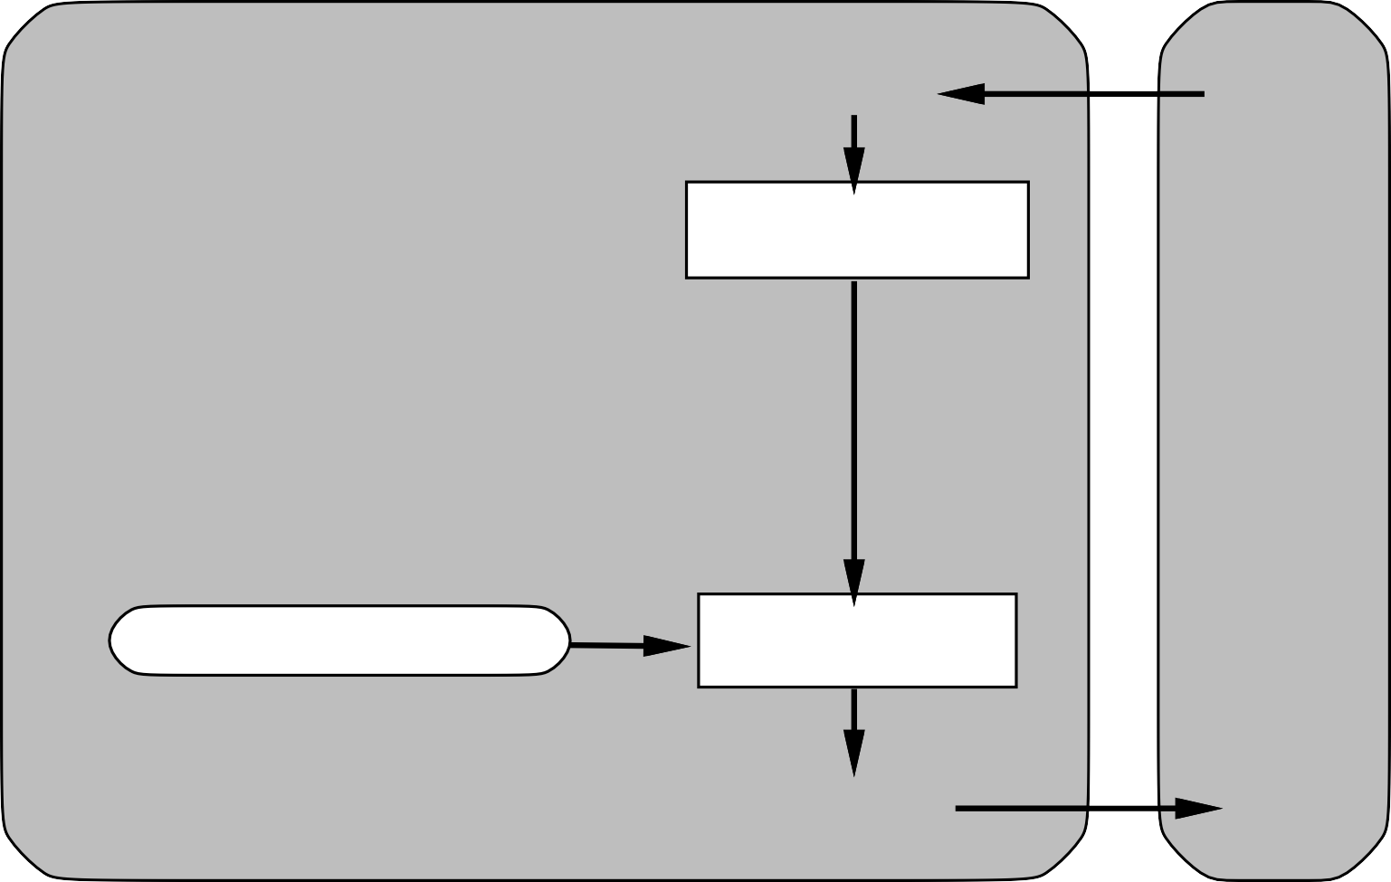
Simple reflex agents
Agent
Sensors
What the world is like now
Environment
Condition−action rules
What action I should do now
Actuators

Slide 21
Example: Vacuum Agent
function Simple-Reflex-Agent([location, status]) returns an action
if status = Dirty then return Suck
else if location = A then return Right
else if location = B then return Left
Act in a reflective way in response to perceptions only
No memory to persist information which has being used
The agent acts always the same way, without accounting what was the last thing he did

Slide 22
Example: Vacuum Agent
function Table-driven-Reflex-Agent (percept) returns an action
persistent: percepts, a sequence, initially empty
table, a table of actions, indexed by percepts, initially fully specified
append percept to the end of percepts
action ←Lookup (percepts, table)
return action
Acts always the same way in response to a given percept
Memorizes the past perceptions in table percepts for auding purposes
Does not remember the actions in response to them
The agent acts always the same way, without accounting what was the last thing he did in response to the perceptions

Slide 23
Representational Issues
How can we represent the perceptions (i.e., in Python)?
How can we represent the actions (i.e., in Python)?
Does the lookup depends on the data structure used to represent the perceptions?
Does the lookup depends on the data structure used to represent the actions?
How can we speed-up the lookup into the table?

Slide 24
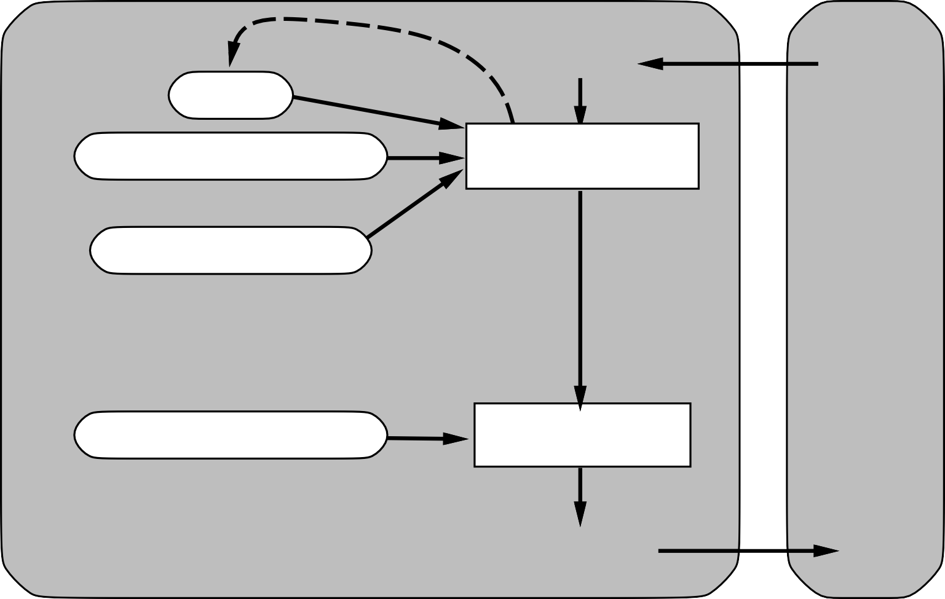
Reflex agents with state
Sensors
State
How the world evolves
What the world is like now
Environment
What my actions do
Condition−action rules
What action I should do now
Agent
Actuators

Slide 25
Example: Resource Planning Agents
function Rule-based-Planning-Agent (percept) returns an action
persistent: rules, a set of condition–action rules in format Condition.Action
state ← Iinterprete-Input (percept)
rule ← Rule-Match (state, rules)
action ← rule.Action
return action
The agent acts differently depending on a condition of the current state of the controlled resource - location, money, time
The size of the memory is constant
Examples: Transportation planners, Holliday planners, Meeting plannersetc.

Slide 26
Representational Issues
How can we represent the rules (i.e., in Python)?
Does the search for matching rules depend on the data structures used to represent the rules?
Does the search for matching rules depend on the data structures used to represent the states?
Does the search for matching rules depend on the data structures used to represent the perceptions?
How can we speed-up the rule match?

Slide 27
Types of agents depending on their memory process
Depending on the length and the characteristic of the memorized history of perceptions and actions there are different types:
Recurrent agents – remember only the last action and perception
Markov agents – account the accumulated history of their own actions and perceptions
Stochastic agents – act according to the probabilistic characteristics of the historical lines of actions and perceptions

Slide 28
Complex Model-based Resource Planning Agents
function Model-Based-Planning-Agent(percept) returns an action
persistent: state, the agent’s current conception of the world state
transition model, a description of how the next state depends on
the current state and action
sensor model, a description of how the current world state is reflected
in the agent’s percepts
rules, a set of condition–action rules
action, the most recent action, initially none
state←Update-State (state, action, percept, transition model, sensor model)
rule←Rule-Match (state, rules)
action ←rule.Action
return action
The agent keeps track of the current state of the world in an internal model
It may account the dependence of the perception of the world from the model
It also may account the dependence of the possible actions from the current state through a separate transition model

Slide 29
Representational Issues
How can we represent the states (i.e., in Python)?
Does the updating of states depend on the data structures used to represent the states?
Does the search for matching rules depend on the data structures used to represent the states?
Does the search for matching rules depend on the data structures used to represent the perceptions?
How can we speed-up the rule match?

Slide 30

Goal-driven agents
Sensors
State
How the world evolves
What the world is like now
Environment
What my actions do
What it will be like if I do action A
Goals
What action I should do now
Agent
Actuators

Slide 31
Goal-driven agents
The agent maintains a model of his goals
The goals depend on the state of the world in which the agent acts
In more complex case the goals may also depend on the past actions (optimization)

Slide 32
Representational Issues
How can we represent the goals (i.e., in Python)?
Does the updating of states depend on the data structures used to represent the states?
Does the updating of states depend on the data structures used to represent the goals?
Does the search for matching rules depend on the data structures used to represent the states?
Does the search for matching rules depend on the data structures used to represent the perceptions?
Does the search for matching rules depend on the data structures used to represent the goals?
How can we speed-up the rule match?

Slide 33

Utility-based agents
Sensors
State
How the world evolves
What the world is like now
Environment
What my actions do
What it will be like if I do action A
Utility
How happy I will be in such a state
What action I should do now
Agent
Actuators

Slide 34
Utility-based agents
The agent measures the degree of achieving his goals by acting
The choice of actions depends on the degree to which they can improve the chances and a separate policy
In more complex case the goals may also depend on the change of the policy (adaptation)

Slide 35
Representational Issues
How can we represent the utilities?
Does the complexity of rule matching depend on the utility function?
How can we represent the change of the utility function?
Does the complexity of rule matching depend on the changes in the utility function?

Slide 36
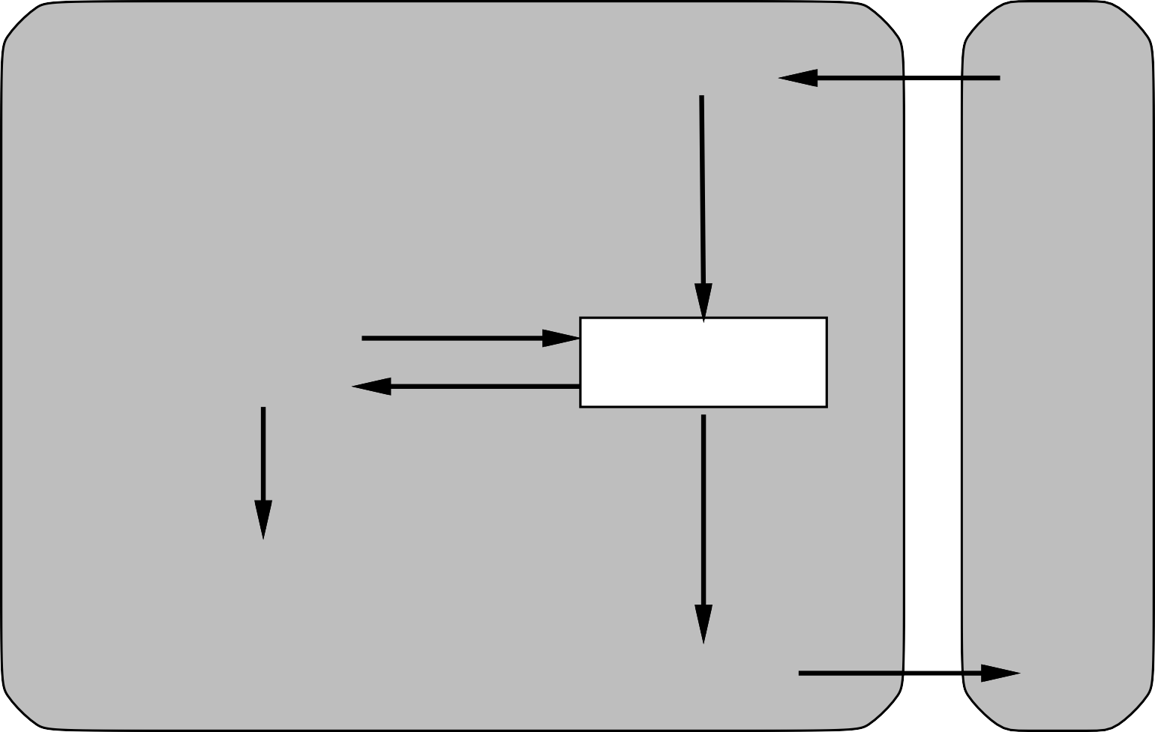
Learning agents
Performance standard
Critic
Sensors
feedback
changes
Environment
Learning element
Performance element
knowledge
learning goals
Problem generator
Agent
Actuators

Slide 37
Learning agents
The agents may learn to change their goals (model learning)
The agents may learn to change their models (policy learning)
They may learn to change their policies (behaviour learning)

Slide 38
Representational Issues
How to represent the learning?
Does the learning process affect the rule matching?

Slide 39
Summary
Agents interact with environments through actuators and sensors
The performance measure evaluates the environment history
The agent function describes what the agent does in all circumstances
PEAS descriptions define the task for building AI agents
Agent programs implement the agent functions
Environments are categorized along several dimensions (observable, deterministic, episodic, static, discrete, single-agent)
Several basic agent architectures exist (reflex, reflex with state, goal-based, utility-based)
The learning agents can learn different things during operation (models, goals, policies)
They determine the methods for designing and implementing the AI agents

